Slide 2
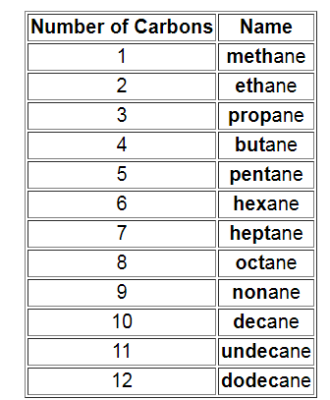
Alkanes - saturated hydrocarbons The names of the straight chain saturated
hydrocarbons for up to a 12 carbon chain are shown below.
The names of the substituents formed by the removal of
one hydrogen from the end of the chain is obtained by
changing the suffix -ane to -yl.

Slide 3
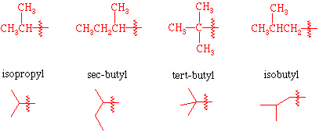
There are a few common branched substituents
which you should memorize. These are shown below.

Slide 4
Here is a simple list of rules to follow. Some examples are given at the end of the list.
Identify the longest carbon chain. This chain is called the parent chain.
Identify all of the substituents (groups appending from the parent chain).
Number the carbons of the parent chain from the end that gives the substituents the lowest numbers. When compairing a series of numbers, the series that is the "lowest" is the one which contains the lowest number at the occasion of the first difference. If two or more side chains are in equivalent positions, assign the lowest number to the one which will come first in the name.
If the same substituent occurs more than once, the location of each point on which the substituent occurs is given. In addition, the number of times the substituent group occurs is indicated by a prefix (di, tri, tetra, etc.).

Slide 5
If there are two or more different substituents they are listed in alphabetical order using the base name (ignore the prefixes). The only prefix which is used when putting the substituents in alphabetical order is iso as in isopropyl or isobutyl. The prefixes sec- and tert- are not used in determining alphabetical order except when compared with each other.
If chains of equal length are competing for selection as the parent chain, then the choice goes in series to: a) the chain which has the greatest number of side chains. b) the chain whose substituents have the lowest- numbers. c) the chain having the greatest number of carbon atoms in the smaller side chain. d)the chain having the least branched side chains.

Slide 6
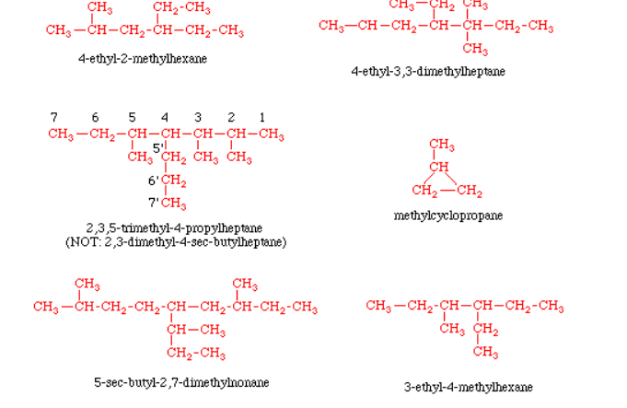
:
Here are some examples

Slide 7
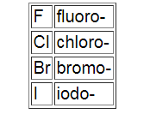
Alkyl halides The halogen is treated as a substituent on an alkane chain.
The halo- substituent is considered of
equal rank with an alkyl substituent in the numbering of the
parent chain. The halogens are represented as follows:
Here are some examples:

Slide 8
Alkenes and Alkynes - unsaturated hydrocarbons Double bonds in hydrocarbons are indicated by replacing the suffix -ane with -ene.
If there is more than one double bond, the suffix is expanded to include a prefix that indicates the number of double bonds present (-adiene, -atriene, etc.). Triple bonds are named in a similar way using the suffix -yne. The position of the multiple bond(s) within the parent chain is(are) indicated by placing the number(s) of the first carbon of the multiple bond(s) directly in front of the base name.
Here is an important list of rules to follow:
The parent chain is numbered so that the multiple bonds have the lowest numbers (double and triple bonds have priority over alkyl and halo substituents).
When both double and triple bonds are present, numbers as low as possible are given to double and triple bonds even though this may at times give "-yne" a lower number than "-ene". When there is a choice in numbering, the double bonds are given the lowest numbers.
When both double and triple bonds are present, the -en suffix follows the parent chain directly and the -yne suffix follows the -en suffix (notice that the e is left off, -en instead of -ene). The location of the double bond(s) is(are) indicated before the parent name as before, and the location of the triple bond(s) is(are) indicated between the -en and -yne suffixes. See below for examples.

Slide 9
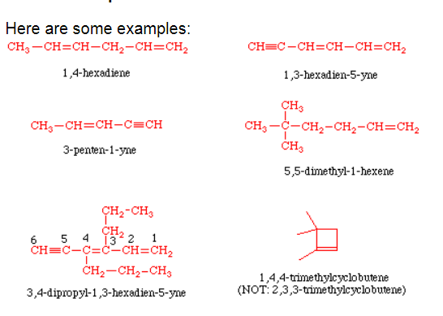

Slide 10
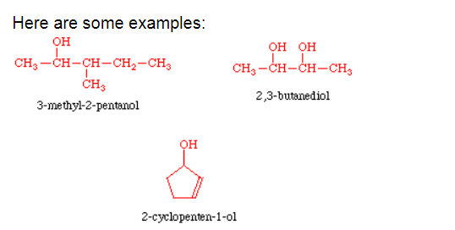
Alcohols Alcohols are named by replacing the suffix -ane with -anol. If there is more than one hydroxyl group (-OH), the suffix is expanded to include a prefix that indicates the number of hydroxyl groups present (-anediol, -anetriol, etc.).

Slide 11
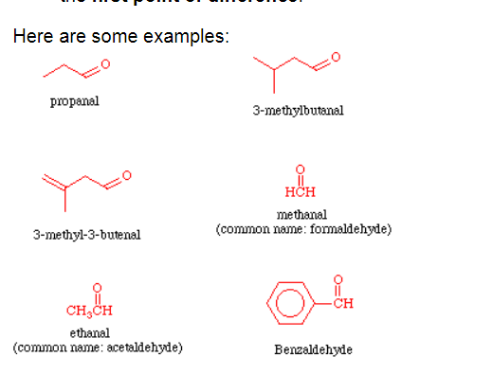
ALDEHYDES

Slide 12
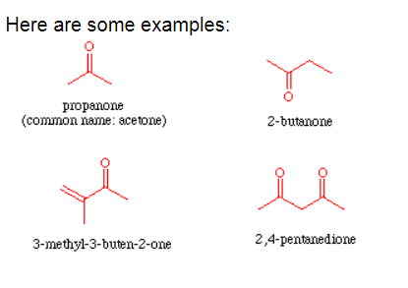
KETONES

Slide 13
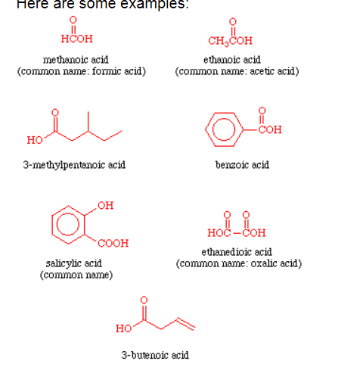
CARBOXYLIC ACIDS

Slide 16
